Slide 1
Buccaneer Protective Coatings
WIREFRAMES & REFERENCE SITES

Slide 2
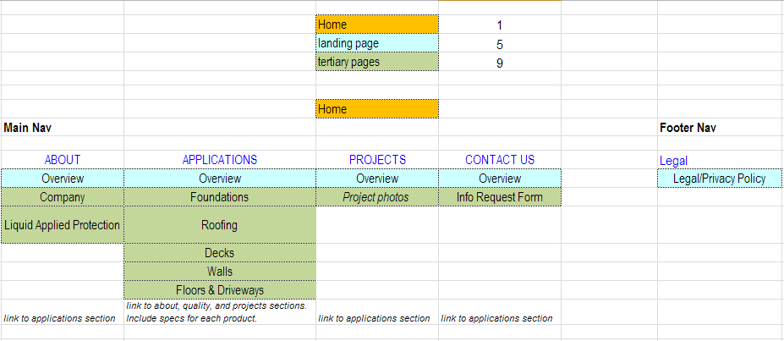
Sitemap

Slide 3
Site Needs
Homepage
Clearly describes Buccaneer Protective Coatings offering and differentiators
Highlight key site features (products, company)
Projects
Overall/Design
Influence from these industry related sites: http://alecwilliamsconstruction.ca/, http://www.visageinfo.com/, http://persimmoncontracting.com/, http://dovetail-demo.squarespace.com/
White space
Clean
Simple navigation
Source of information for engineering and architecture firms
Full footer navigation
Contact information central
Responsive (hand held)
Products to be broken down by surface and then broken down further by specific products
Target Audiences
Architecture firms
Engineering firms
Building owners
Applicators (I.e. painting companies)

Slide 4
WIREFRAME
HOMEPAGE

Slide 5
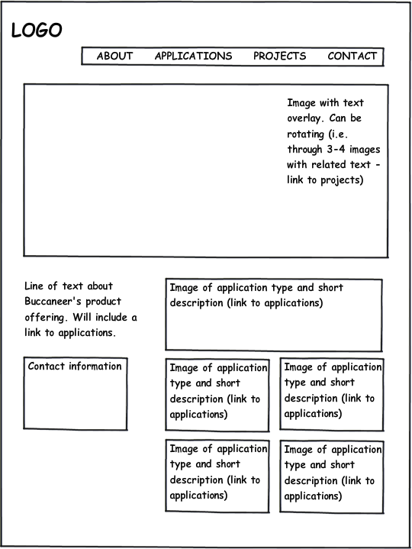

Slide 6
WIREFRAME
INTERNAL PAGE

Slide 7
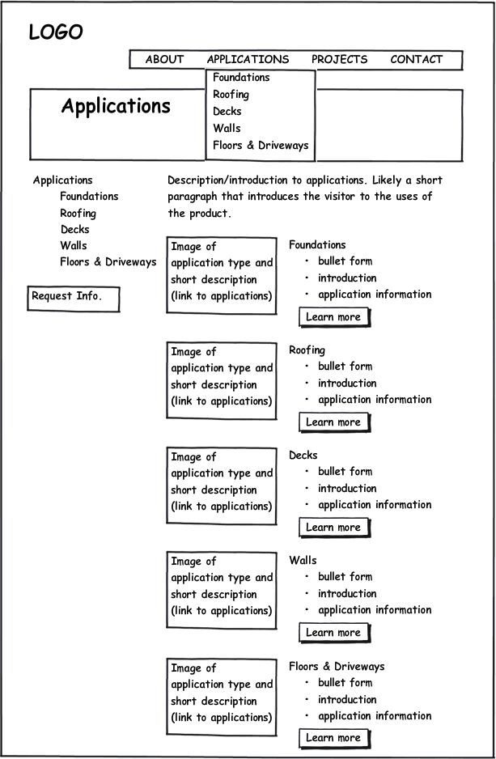
Please note, I am showing both the drop down and left hand navigation. The next slide shows just the left hand navigation (if you weren’t hovering over the section drop down).

Slide 8
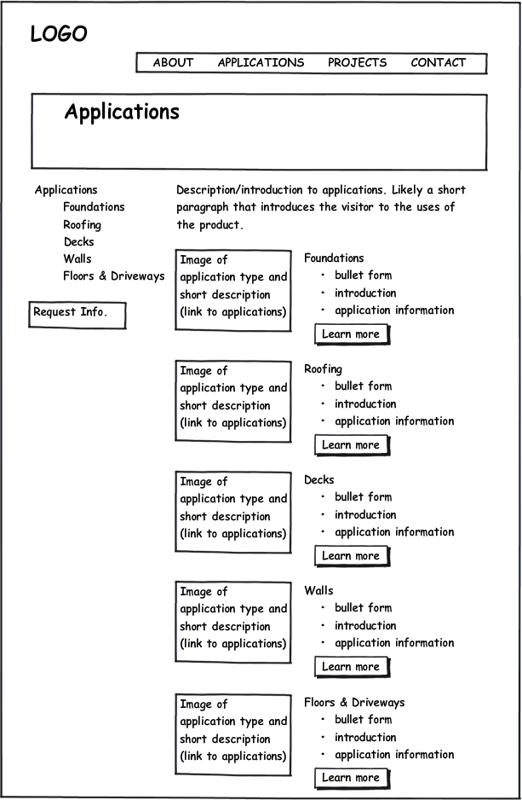

Slide 9
REFERENCE SITES
HOMEPAGE

Slide 10
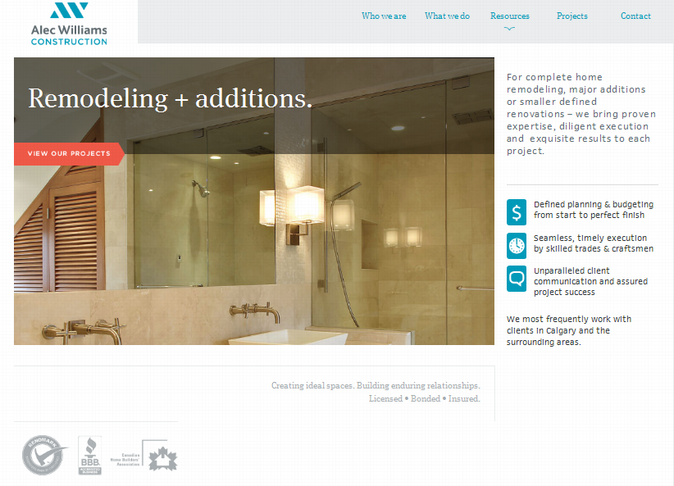
www.alecwilliamsconstruction.ca

Slide 11
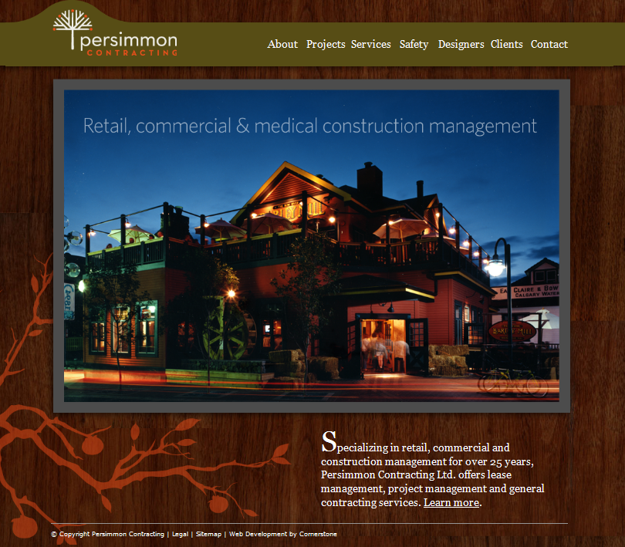
www.persimmoncontracting.ca

Slide 12
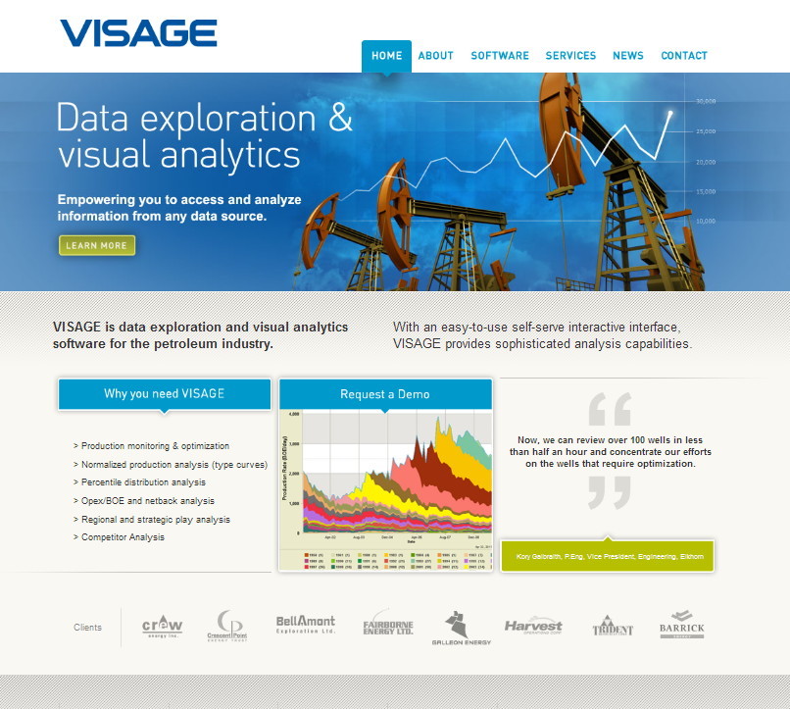
www.visgeinfo.ca

Slide 13
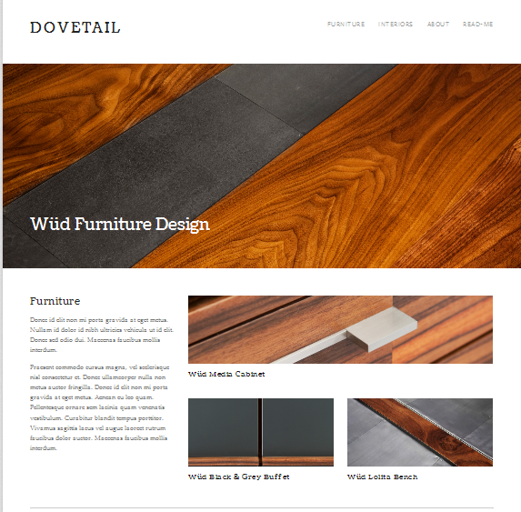
http://dovetail-demo.squarespace.com/

Slide 14
REFERENCE SITES
INTERNAL PAGES

Slide 15
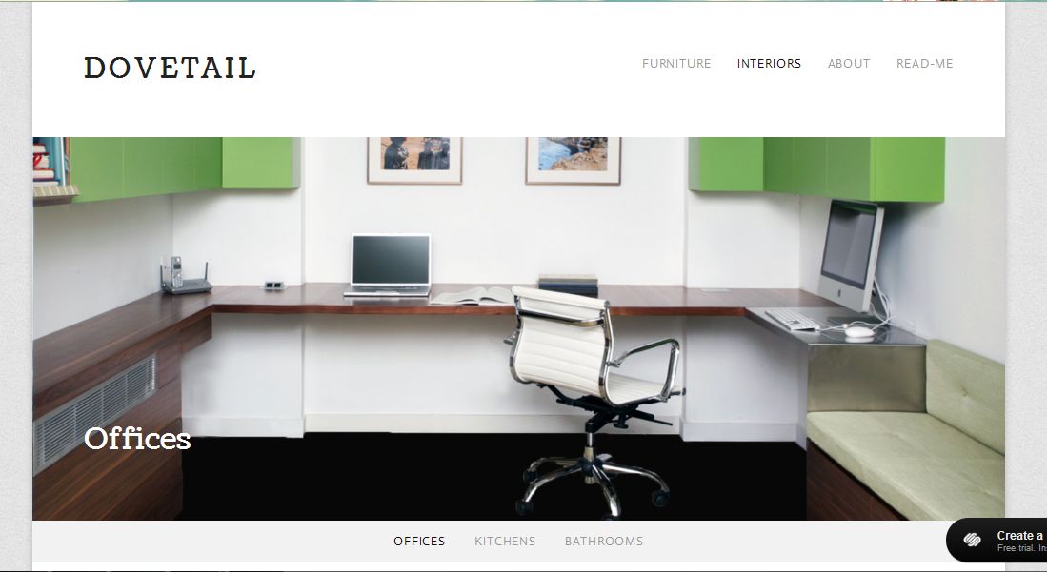

Slide 16
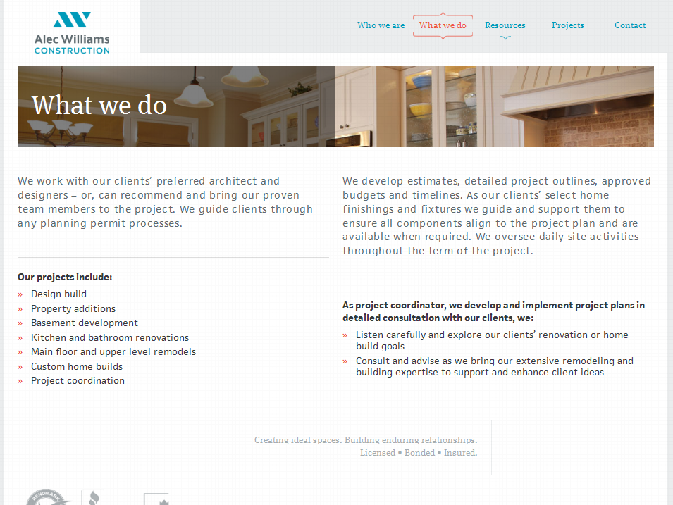

Slide 17
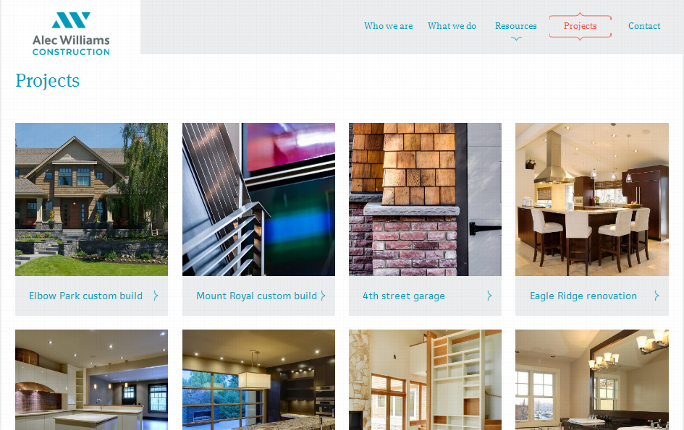

Slide 18
